Slide 1

Diagnose your Golang App anytime anywhere!
Mateusz Dymiński

Slide 2
Whoami
Mateusz Dymiński
Software Developer at Nokia
9+ exp with Java
5+ exp with Go
One of the organizer GoWroc - Golang Wroclaw Meetup
Github: github.com/mateuszdyminski
Twitter: @m_dyminski
LinkedIn: linkedin.com/in/mdyminski

Slide 3

github.com/mateuszdyminski/go-diagnose

Slide 4
Agenda
Debugging
Profiling
Tracing
Instrumentation vs scalability – it was covered by Prakash talk in deatils

Slide 5

Debugging

Slide 6
Debugging
Debugging allows us to pause a Go program and examine its execution. Program state and flow can be verified with debugging.

Slide 7
Application
Simplest HTTP server with Add handler
func main() {
http.Handle("/add", http.HandlerFunc(addHandler))
log.Println("Starting HTTP server on port 8081")
http.ListenAndServe(":8081", http.DefaultServeMux)
}
Request:
http://localhost:8081/add?vals=1,2,4
Response:
results:
sum of 1,2,4 is 7.000000

Slide 8
Handler
func addHandler(w http.ResponseWriter, r *http.Request) {
valStr := r.URL.Query().Get("vals")
vals := strings.Split(valStr, ",")
acc := 0.0
for _, val := range vals {
valInt, err := strconv.Atoi(val)
if err != nil {
continue
}
acc = acc + float64(valInt)
}
w.Write([]byte("results: \n"))
fmt.Fprintf(w, "sum of %v is %f\n", valStr, acc)
}

Slide 9

Old Way of Debugging

Slide 10
Old Way of Debugging
func addHandler(w http.ResponseWriter, r *http.Request) {
valStr := r.URL.Query().Get("vals")
log.Printf("got values: %s \n", valStr)
vals := strings.Split(valStr, ",")
log.Printf("values after split: %v \n", vals)
acc := 0.0
for i, val := range vals {
valInt, err := strconv.Atoi(val)
if err != nil {
log.Printf("can't parse val: %s err: %s, skipping \n", val, err)
continue
} else {
log.Printf("val: %s parsed properly\n", val)
}
acc = acc + float64(valInt)
log.Printf("temp sum after %d of values is: %f\n", i+1, acc)
}
log.Printf("sum of %s is: %v \n", valStr, vals)
w.Write([]byte("results: \n"))
fmt.Fprintf(w, "sum of %v is %f\n", valStr, acc)
}
That’s what real HACKER does !!!!!!!!

Slide 11

We can do better

Slide 12
Go users mostly use the following debuggers
GDB: Go provides GDB support via the standard Go compiler and Gccgo. The stack management, threading, and runtime contain aspects that differ enough from the execution model GDB expects that they can confuse the debugger, even when the program is compiled with gccgo.
Delve: Delve is a debugger for the Go programming language. It has support for Go’s runtime concepts and built-in types. Delve is trying to be a fully featured reliable debugger for Go programs.

Slide 13
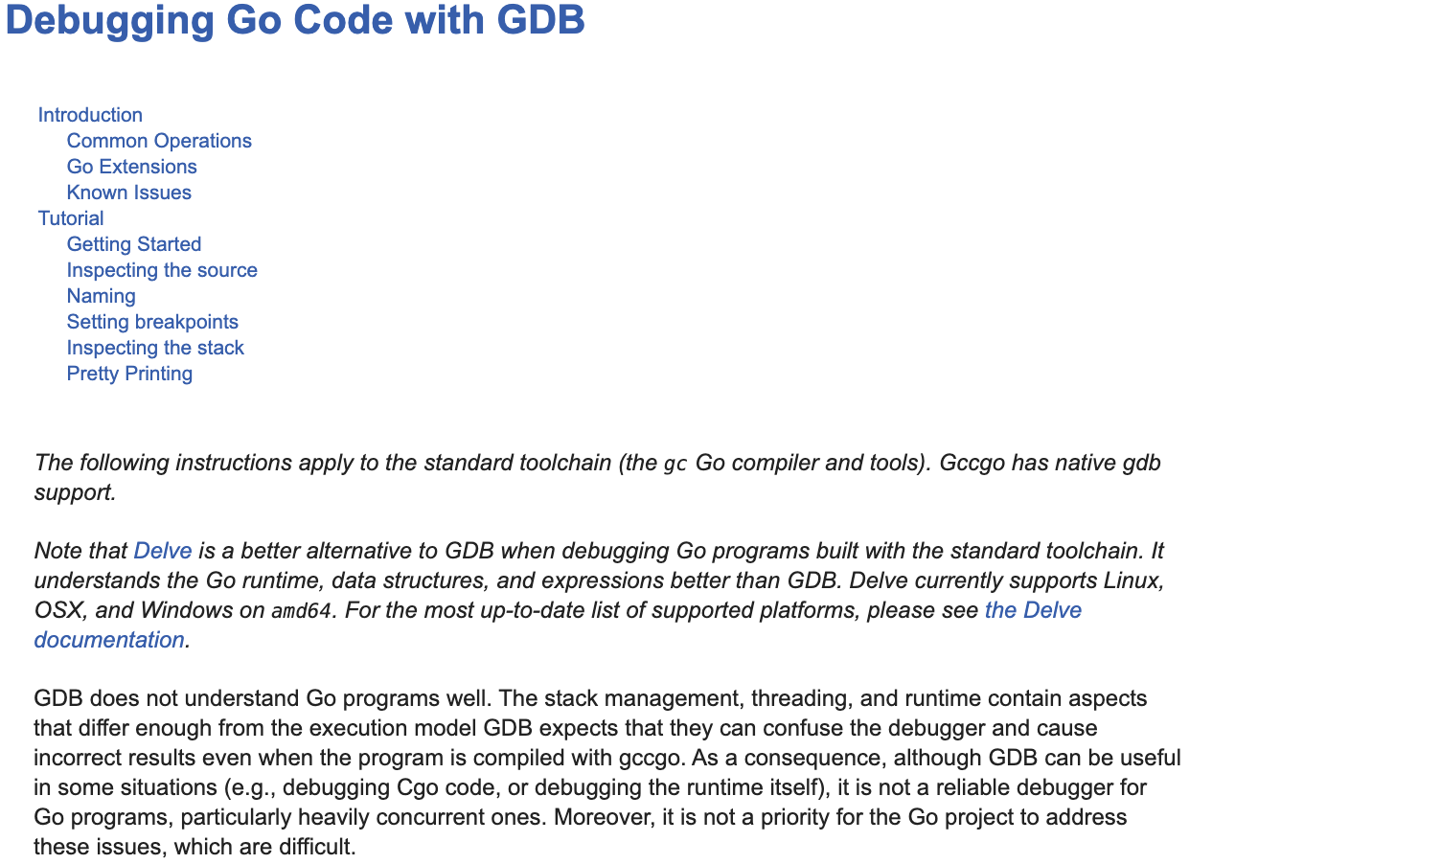
GDB

Slide 14


Slide 15
Delve debug flow
$ dlv debug github.com/mateuszdyminski/go-diagnose/debug
Invoking that command will cause Delve to:
compile the program in a way most suitable for debugging
execute previously compiled program
attach to the program and begin a debug session
Now, when the debug session has first started you are at the very beginning of the program's initialization. To get to someplace more useful you're going to want to set a breakpoint or two and continue execution to that point.

Slide 16
Demo

Slide 17

Remote Debugging

Slide 18
Remote Debugging with Delve
1. Compile our App with proper flags:
$ go build -gcflags "all=-N -l" -ldflags=-compressdwarf=false -o app-mac .
-gcflags "all=-N -l” disables inlining and most optimizations.
-ldflags=-compressdwarf=false Go 1.11 started compressing debug information to reduce binary sizes. This is natively supported by Delve, but neither LLDB nor GDB support compressed debug info on macOS. If you are using LLDB or GDB, there are two workarounds: build binaries with -ldflags=-compressdwarf=false, or use splitdwarf
2. Run application
$ ./app-mac
3. Run Delve server in headless mode:
$ dlv attach --headless --listen=:2345 --log --api-version=2 --accept-multiclient=true $(pgrep app-mac)
4. Attach IDE Debugger session to server

Slide 19
Demo

Slide 20

Remote Debugging App in Docker

Slide 21
Remote Debugging with Delve in Docker
Dockerfile
FROM golang:1.12.5
# Delve Configuration
RUN go get -u -v github.com/derekparker/delve/cmd/dlv
EXPOSE 40000
# App Configuration
WORKDIR /go/src/github.com/mateuszdyminski/go-diagnose
ADD main.go .
RUN go build -gcflags="all=-N -l" -o app .
EXPOSE 8081
CMD [ "dlv", "exec", "/go/src/github.com/mateuszdyminski/go-diagnose/app", "--listen=:40000", "--headless=true", "--api-version=2", "--log" ]

Slide 22
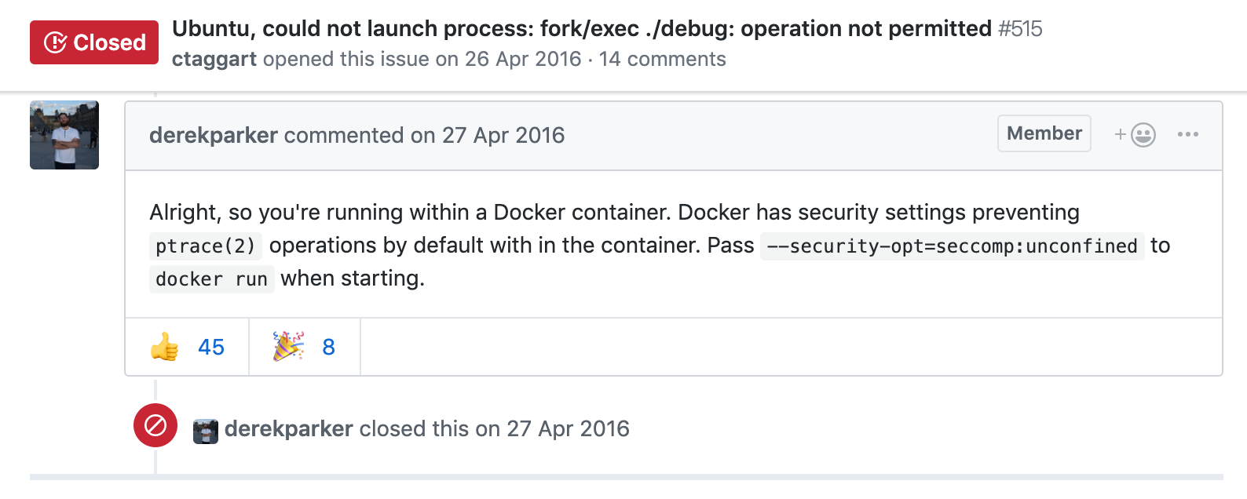
Remote Debugging with Delve in Docker
Run Docker container:
$ docker run -d -p 8081:8081 -p 40000:40000 mateuszdyminski/debug:latest
Does not work :/

Slide 23
Remote Debugging with Delve in Docker
Run Docker container:
$ docker run -d -p 8081:8081 -p 40000:40000 --security-opt=seccomp:unconfined mateuszdyminski/debug:latest

Slide 24
Demo

Slide 25

Postmortem Debugging

Slide 26
Postmortem Debugging
Sometimes our application dies and we would like to analyze what happend.
It is possible to obtain core files from Go programs and use delve or gdb to debug.
A core dump file is a file that contains the memory dump of a running process and its process status.

Slide 27
Core File – How to
Crash dumps, these are basically core dumps written to disk when a program is crashing. Go doesn’t enable crash dumps by default but gives you this option on Ctrl+backslash when GOTRACEBACK env variable is set to “crash”.
$ GOTRACEBACK=crash ./app-mac
(Ctrl+\)
Another option is to retrieve a core dump from a running process without having to kill a process. With gcore, it is possible to get the core files without crashing. Let’s start the server again:
$ ./app-mac &
$ gcore 3214 # 3214 is the PID of app-mac

Slide 28
Postmortem Debugging
We have a dump without crashing the process. The next step is to load the core file to delve and start analyzing.
$ dlv core ./app-mac /cores/app-mac-99182-20190611T210621Z
This is no different than the typical delve interactive. You can backtrace, list, see variables, and more. Some features will be disabled given a core dump is a snapshot and not a currently running proces.

Slide 29
Debugging - takeaways
Debugging local Application is very easy
Attaching to production Application(non-Docker) is pretty straighforward, but:
it stops the execution of the entire App when we start dlv server
we need to have proper binaries – compiled without the optimizations
we need to restart dlv server everytime we would like to attach debugger again
Attaching to production Application in container is problematic:
we need to create dedicated container image to make debugging possible
we need to run container with unsecure way
Even if our Application dies is not too late for debugger

Slide 30

Profiling

Slide 31
Profiling
Profiling tools analyze the complexity and costs of a Go program such as its memory usage and frequently called functions to identify the expensive sections of a Go program.

Slide 32
pprof
pprof is a tool for visualization and analysis of profiling data.
Go has powerful profiling built in to the runtime
CPU profiles (stack sampling)
Heap profiles using allocation profiling
and more (block profiles, threadcreate, goroutine, mutex, etc)
Accessible through pprof and runtime packages.

Slide 33
pprof
Multiple ways to get started with profiling:
Through tests and benchmarks, using the -cpuprofile and -memprofile flags.
import _ net/http/pprof
Start the profile from code by calling runtime.StartCPUProfile or runtime.WriteHeapProfile

Slide 34

Profiling – import

Slide 35
pprof – import
import (
"net/http"
_ "net/http/pprof"
"github.com/mateuszdyminski/go-diagnose/profile/handlers"
)
const hostPort = ":8090"
func main() {
flag.Parse()
http.HandleFunc("/statsHello", handlers.WithStats(handlers.Hello))
http.HandleFunc("/hello", handlers.Hello)
log.Printf("Starting HTTP server on port %s \n", hostPort)
if err := http.ListenAndServe(hostPort, nil); err != nil {
log.Fatalf("HTTP server failed: %v", err)
}
}

Slide 36
pprof – import
This mechanism is dangerously simple. It only requires one import which could be anywhere!
Security issues:
Function names and file paths are revealed.
Profiling data may reveal business sensitive information (for example traffic to a web server)
Profiling degrades performance, providing a vector for a DoS attack
Depending on your application, leaving a debugging server may not necessarily be a critical security hole. At a minimum it’s inadvisable, but it could be much worse.

Slide 37
pprof – import
func main() {
flag.Parse()
// pprof configuration
go func() {
mux := http.NewServeMux()
mux.HandleFunc("/", pprof.Index)
mux.HandleFunc("/cmdline", pprof.Cmdline)
mux.HandleFunc("/profile", pprof.Profile)
mux.HandleFunc("/symbol", pprof.Symbol)
mux.HandleFunc("/trace", pprof.Trace)
log.Println("Starting profile HTTP server on port 1337")
if err := http.ListenAndServe(":1337", mux); err != nil {
log.Fatalf("HTTP server failed: %v", err)
}
}()
// register handlers
http.HandleFunc("/statsHello", handlers.WithStats(handlers.Hello))
http.HandleFunc("/hello", handlers.Hello)
log.Printf("Starting HTTP server on port %s \n", hostPort)
if err := http.ListenAndServe(hostPort, nil); err != nil {
log.Fatalf("HTTP server failed: %v", err)
}
}
Different HTTP server for debug

Slide 38
pprof - import
To fetch profile from running app and open analysis - web:
$ go tool pprof -http :8091 -seconds 5 http://localhost:8090/debug/pprof/profile
To fetch profile from running app and open analysis - terminal:
$ go tool pprof -seconds 5 http://localhost:8090/debug/pprof/profile
To compare profiles:
$ go tool pprof –base profile-01 profile-02

Slide 39
Demo

Slide 40
Profiling – tests and benchmarks

Slide 41
pprof - tests and benchmarks
Let’s assume that we would like to make profile of following func:
func Fib(n int) int {
if n < 2 {
return n
}
return Fib(n-1) + Fib(n-2)
}
We need to write Benchmark:
func BenchmarkFib10(b *testing.B) {
// run the Fib function b.N times
for n := 0; n < b.N; n++ {
Fib(10)
}
}

Slide 42
pprof - tests and benchmarks
To build CPU profile for a benchmark:
$ go test . -bench . -cpuprofile prof.cpu
To build memory profile for a benchmark:
$ go test . -bench . -memprofile prof.mem
To open pprof analysis in terminal:
$ go tool pprof prof.mem
To open pprof analysis in web browser:
$ go tool pprof -http :8099 prof.mem

Slide 43
Profiling – manual way

Slide 44
pprof – manual way
package main
import (
"os"
"runtime/pprof"
"time"
)
func main() {
memFile, _ := os.Create("./pprof.mem")
cpuFile, _ := os.Create("./pprof.cpu")
defer memFile.Close()
defer cpuFile.Close()
pprof.StartCPUProfile(cpuFile)
go leakyFunction()
// wait some time for initialization of leakyFunction
time.Sleep(500 * time.Millisecond)
pprof.WriteHeapProfile(memFile)
pprof.StopCPUProfile()
}

Slide 45
Profiling - takeaways
Golang creators/maintainers did great job with profiling
Blank import is very powerful but dangerous:
It makes your application unsecure
Always run debug endpoints on different HTTP port than production server
Profiling via benchmarks is the easiest way to optimise your func
Use flamegraph
Use web-based pprof analysis
Don’t prematurely optimize

Slide 46
Tracing

Slide 47
Execution Tracing
The execution trace captures a wide range of execution events such as goroutine creation/blocking/unblocking, syscall enter/exit/block, GC-related events, changes of heap size, processor start/stop, etc. A precise nanosecond-precision timestamp and a stac trace is captured for most events. The generated trace can be interpreted using go tool trace.

Slide 48
trace
trace is a tool for visualization and analysis of program execution.
Go has powerful tracing built in to the runtime
View trace - The most complex, powerful and interactive visualization shows a timeline of the entire program execution.
Goroutine analysis - Shows how many of each kind of goroutines were created during the entire execution
Network/Sync/Syscall blocking profile - These contain graphs that displays how long goroutines spent blocked on each of these resources.
Scheduler latency profiler - Provides timing for scheduler level information showing where time is most spent scheduling.
Accessible through pprof and runtime packages.

Slide 49
What problems can I solve with go tool trace?
Diagnosing latency problems
Diagnosing poor parallelism
Detecting Lock Contention

Slide 50
When is go tool trace not appropriate?
Of course, go tool trace can’t solve everything.
if you want to track down slow functions
find where your program is spending most of its CPU time.
For that you should use go tool pprof, which shows the percentage of CPU time spent in each function.

Slide 51
trace
Multiple ways to get started with tracing:
Through tests and benchmarks, using the –trace flag
import _ net/http/pprof and fetch trace with wget or via web browser
Start the profile from code by calling trace.Start

Slide 52
Tracing – tests and benchmarks

Slide 53
trace - tests and benchmarks
Let’s assume that we would like to make trace of following func:
func Fib(n int) int {
if n < 2 {
return n
}
return Fib(n-1) + Fib(n-2)
}
We need to write Benchmark:
func BenchmarkFib10(b *testing.B) {
// run the Fib function b.N times
for n := 0; n < b.N; n++ {
Fib(10)
}
}

Slide 54
trace - tests and benchmarks
To get trace:
$ go test . -bench . -trace trace.out
To open trace analysis in browser:
$ go tool trace trace.out

Slide 55
Tracing – import

Slide 56
trace – import
import (
"net/http"
_ "net/http/pprof"
"github.com/mateuszdyminski/go-diagnose/profile/handlers"
)
const hostPort = ":8090"
func main() {
flag.Parse()
http.HandleFunc("/statsHello", handlers.WithStats(handlers.Hello))
http.HandleFunc("/hello", handlers.Hello)
log.Printf("Starting HTTP server on port %s \n", hostPort)
if err := http.ListenAndServe(hostPort, nil); err != nil {
log.Fatalf("HTTP server failed: %v", err)
}
}

Slide 57
trace - import
To fetch trace from running app:
$ wget http://localhost:8090/debug/pprof/trace?seconds=5 -O 1.trace
To open trace tool – web based only:
$ go tool trace 1.trace

Slide 58
Tracing – manual way

Slide 59
trace – manual way
import (
"fmt"
"log"
"os"
"runtime/trace"
)
// The trace output will be written to the file trace.out
func main() {
f, _ := os.Create("trace.out")
defer f.Close()
trace.Start(f)
defer trace.Stop()
tracedFunc()
}
func tracedFunc() {
fmt.Printf("this function will be traced\n")
}

Slide 60
Tracing – demo

Slide 61

Instrumentation with external tools

Slide 62
Instrumentation
In the context of computer programming, instrumentation refers to an ability to monitor or measure the level of a product's performance, to diagnose errors, and to write trace information.

Slide 63
Instrumentation vs scalability
If we have set of servers scaled horizonally - using profiling and tracing is problematic
So we need to single place where all the metrics and events are kept
The most common tool for that in Golang world is Prometheus, Zipkin or Jaeger

Slide 64
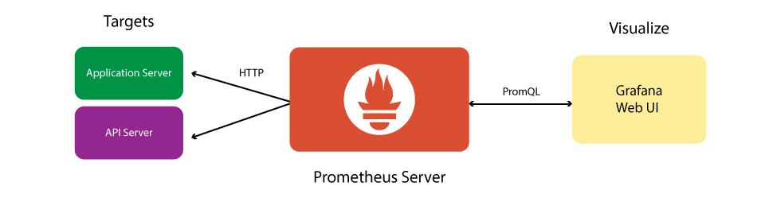
Prometheus flow

Slide 65
How to instrument
The short answer is to instrument everything. Every library, subsystem and service should have at least a few metrics to give you a rough idea of how it is performing.

Slide 66
How to instrument
Instrumentation should be an integral part of your code. Instantiate the metric classes in the same file you use them. This makes going from alert to console to code easy when you are chasing an error.

Slide 67
How to instrument
import (
"github.com/prometheus/client_golang/prometheus/promhttp"
)
func main() {
mux := http.NewServeMux()
// prometheus handler
mux.Handle("/metrics", promhttp.Handler())
// our business logic handlers
mux.HandleFunc("/hello", hello)
inst := prom.NewInstrument()
srv := &http.Server{
Addr: ":8095",
Handler: inst.Wrap(mux),
}
if err := srv.ListenAndServe(); err != nil {
log.Fatal().Msgf("HTTP server failed: %v", err)
}
}

Slide 68
How to instrument
func NewInstrument() *Instrument {
// used for monitoring and alerting (RED method)
histogram := prometheus.NewHistogramVec(prometheus.HistogramOpts{
Subsystem: "http",
Name: "request_duration_seconds",
Help: "Seconds spent serving HTTP requests.",
Buckets: prometheus.DefBuckets,
}, []string{"method", "path", "status"})
prometheus.MustRegister(histogram)
return &Instrument{
Histogram: histogram,
}
}

Slide 69
How to instrument
func (i Instrument) Wrap(next http.Handler) http.Handler {
return http.HandlerFunc(func(w http.ResponseWriter, r *http.Request) {
begin := time.Now()
interceptor := &interceptor{ResponseWriter: w, statusCode: http.StatusOK}
path := urlToLabel(r.URL.Path)
next.ServeHTTP(interceptor, r)
var (
status = strconv.Itoa(interceptor.statusCode)
took = time.Since(begin)
)
log.Info().Msgf("%s - %s %s %s %s %s Took: %s",
getRemoteAddr(r),
r.Method,
r.RequestURI,
r.Proto,
status,
r.UserAgent(),
took.String())
i.Histogram.WithLabelValues(r.Method, path, status).Observe(took.Seconds())
})
}

Slide 70
Instrumentation demo

Slide 71

Takeaways
Delve debugger is still missing some features
Debugging dockerized Application is problematic
You can debug your application even if it dies
Profiling is really easy in Golang
Always remember to expose debug endpoints on different port than production HTTP server
Use profiles created by benchmark – it’s the easiest way to optimise performance of your code
Execution tracing will help you with Locks, GC, poor parallelism, but not with optimizing your func
Instrumenting Go code with tools like Prometheus is really easy
Instrument Go code even if you have no working Prometheus cluster

Slide 72
Takeaways
Delve debugger is still missing some features
Debugging dockerized Application is problematic
You can debug your application even if it dies
Profiling is really easy in Golang
Always remember to expose debug endpoints on different port than production HTTP server
Use profiles created by benchmark – it’s the easiest way to optimise performance of your code
Execution tracing will help you with Locks, GC, poor parallelism, but not with optimizing your func

Slide 73

Q&A

